Slide 1
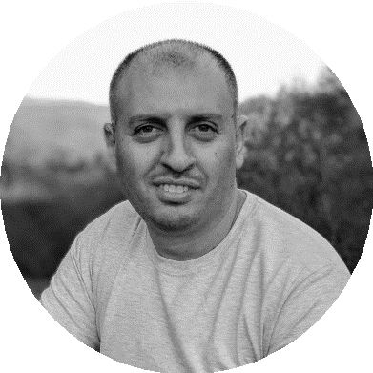
Working with the Operating System
Samer Buna
SOFTWARE ARCHITECT – AGILELABS
@samerbuna | samer.dev

Slide 2
os
fs
child_process

Slide 3
Wrap Up
The os module
The fs module
The child_process module Debugging with Chrome DevTools

Slide 4
Questions?

Slide 5
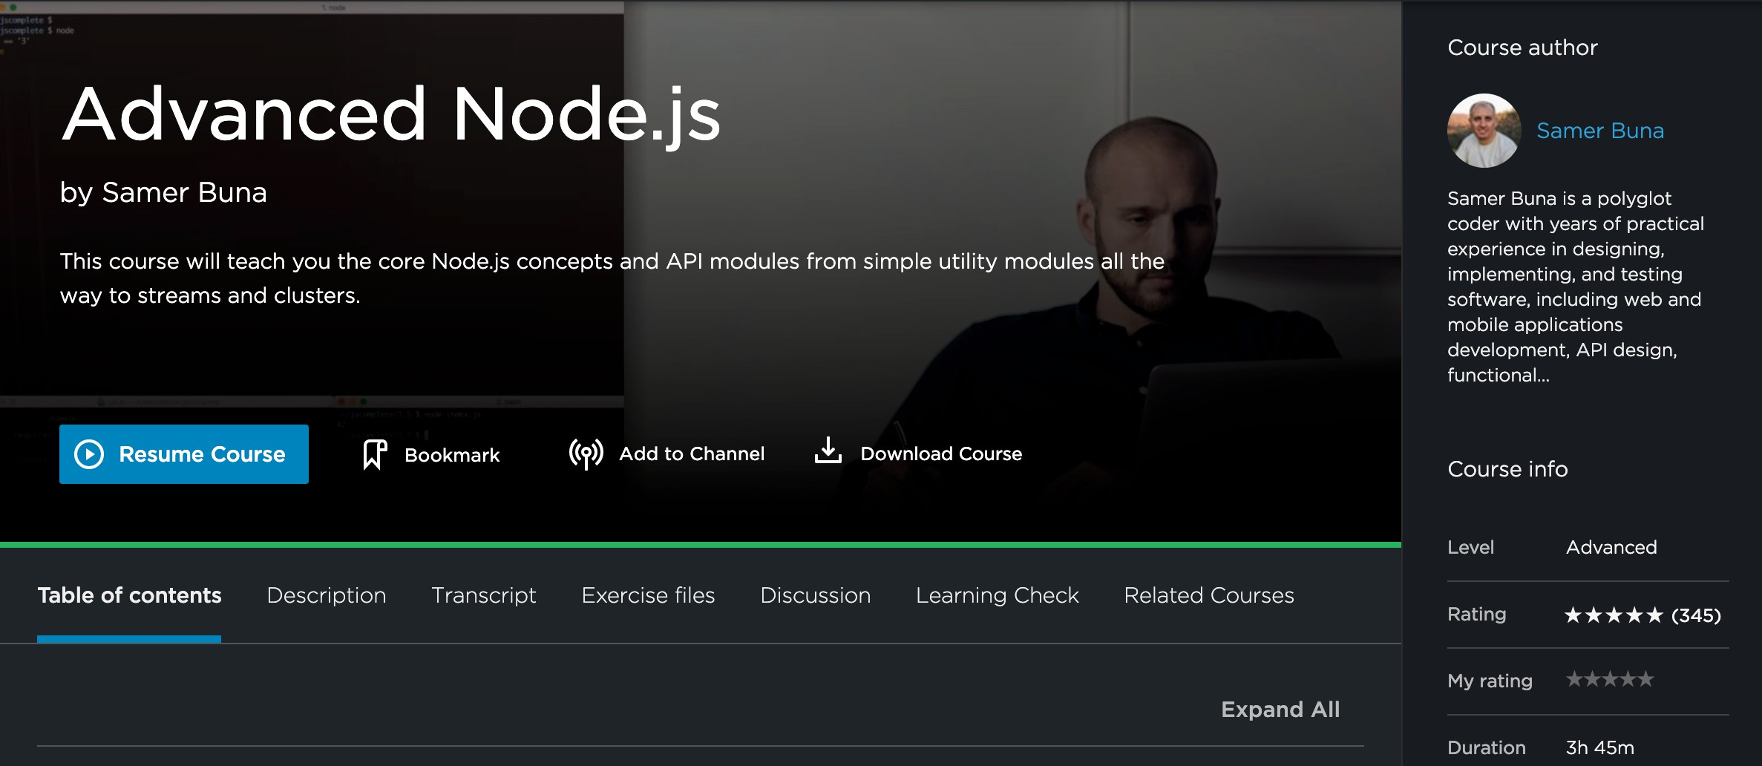

samer.dev/adv-nodejs

Slide 6





Samer Buna — Medium
jsComplete
9 A Medium Corporation [US] https://medium.com/@samerbuna
Medium
Get started
Become an ember
Sign in
Samer Buna ^{F}CZZ
Author for Pluralsight and Lynda and curator of jsComplete.com
Editor of jsCo ma ete Ed eCoc ei s
20I\ Fol ovvers
Profile
Claps
Highlights
Responses
Featured
Samer Buna in jsComplete EdgeCoders

Slide 7





Node.js:
Rat ing history
VERIDIED 8./9.2018
Skill IQ
299
1OOth
percentile
You've skilled up! You now score better than 99% of your peers.
Keep going:
Go to path
Personalized skill analysis O
Based on you Skill IQ
Your gaps
Your strengths
Web and Network
Streams
CLI, REPL, and Globals
Ø g g this assessment

Slide 8
